Slide 1
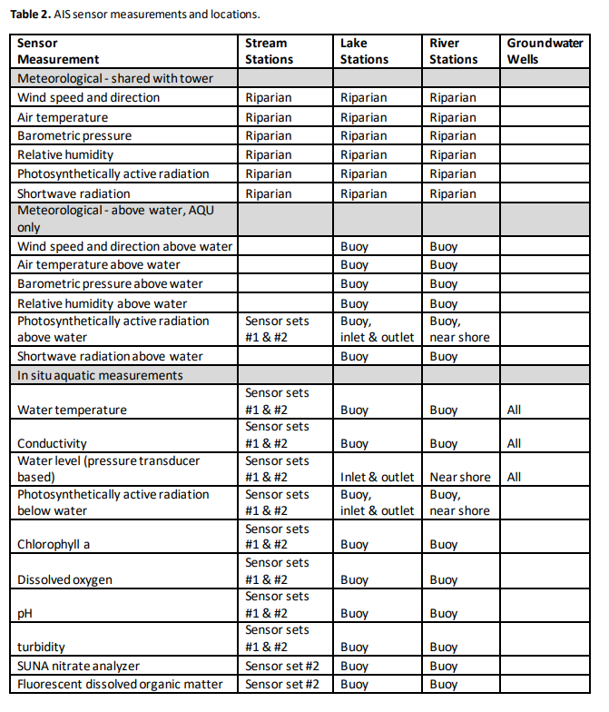
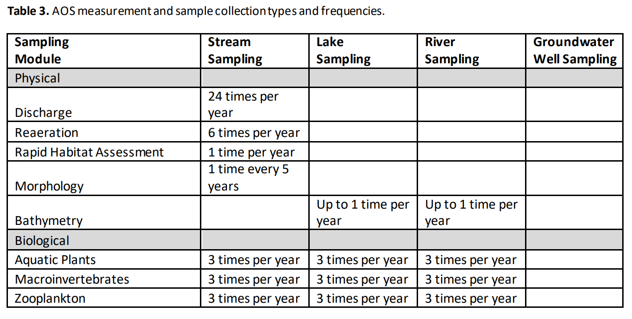
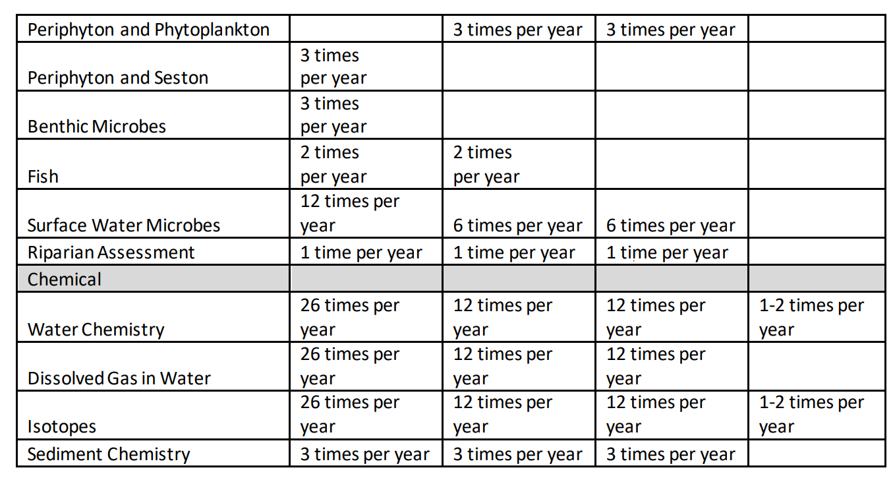
Notes:
Env samples and biological samples
Environmental condition (average and variability)
Biological stock, diversity, and composition
Relationship between env and biology
Comparing biological signals
Diversity patterns through time across various taxa (Macroinvertebrates, microbes, algae, periphyton)

Slide 2
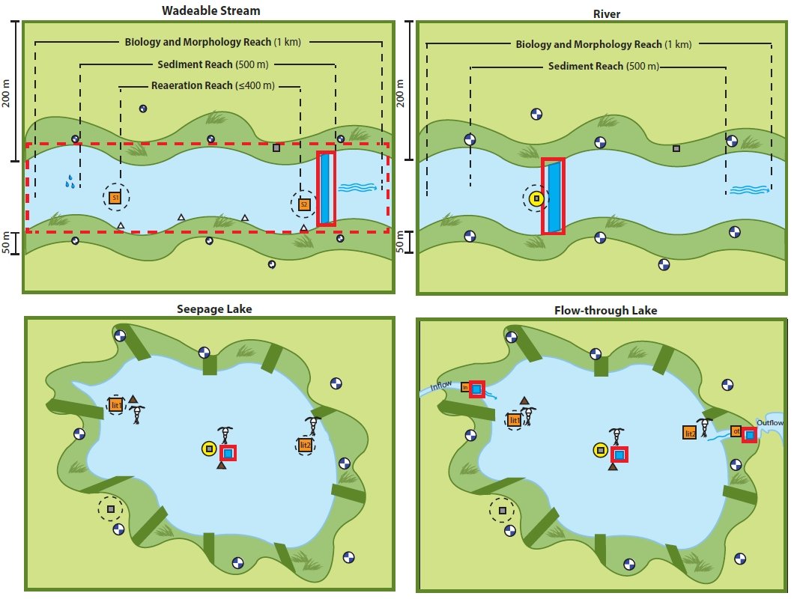
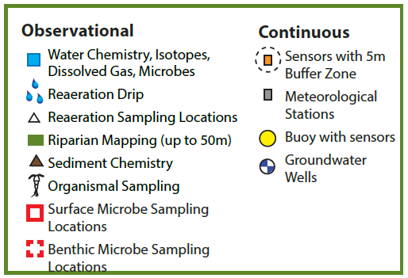
Microbe
Surface water (with chemical samples)
Benthic ()
Cell count (monthly/bimonthly)
16S & ITS (monthly/bimonthly)
Metagenome (sampled annually)

Slide 3
References:
NEON AQUATIC SAMPLING STRATEGY
Werbin et al., 2021. The National Ecological Observatory Network’s soil metagenomes: assembly and basic analysis. doi: 10.12688/f1000research.51494.2

Slide 4
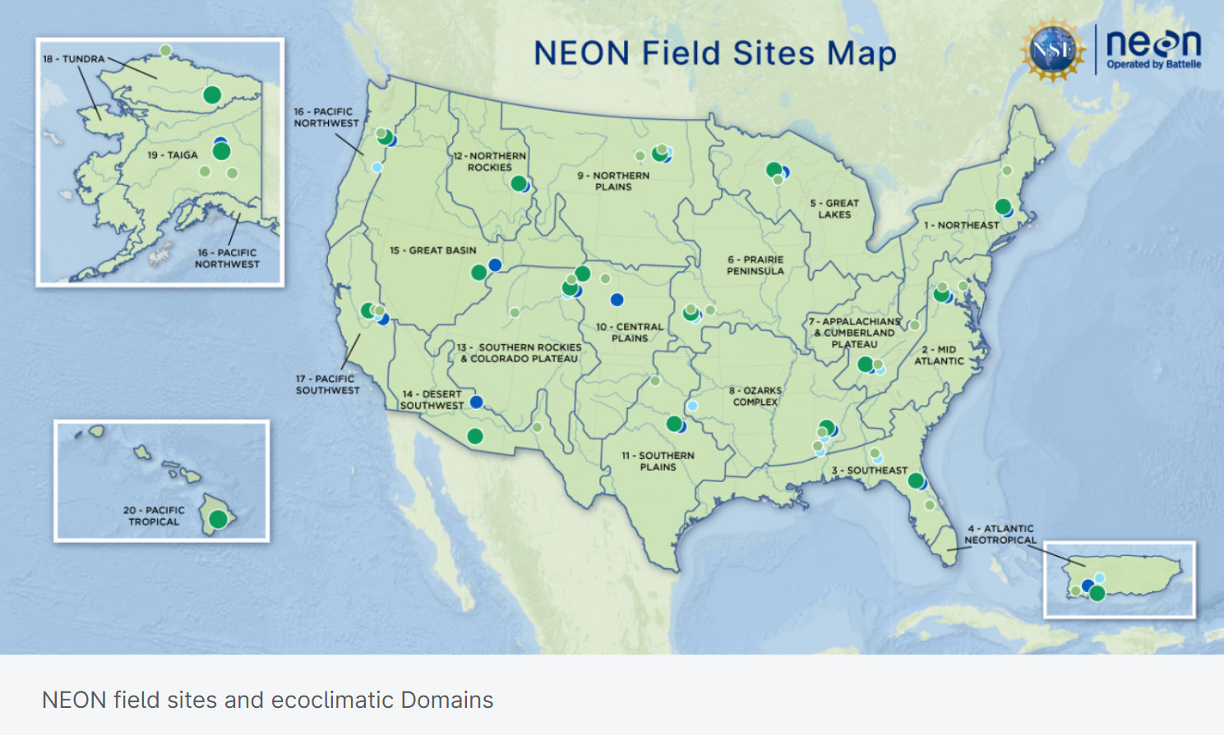
D03 * 2
D05 * 2
D09 * 2
D18 * 1
Notes:
Lakes are heterogeneously distributed (and sampled)

Slide 5
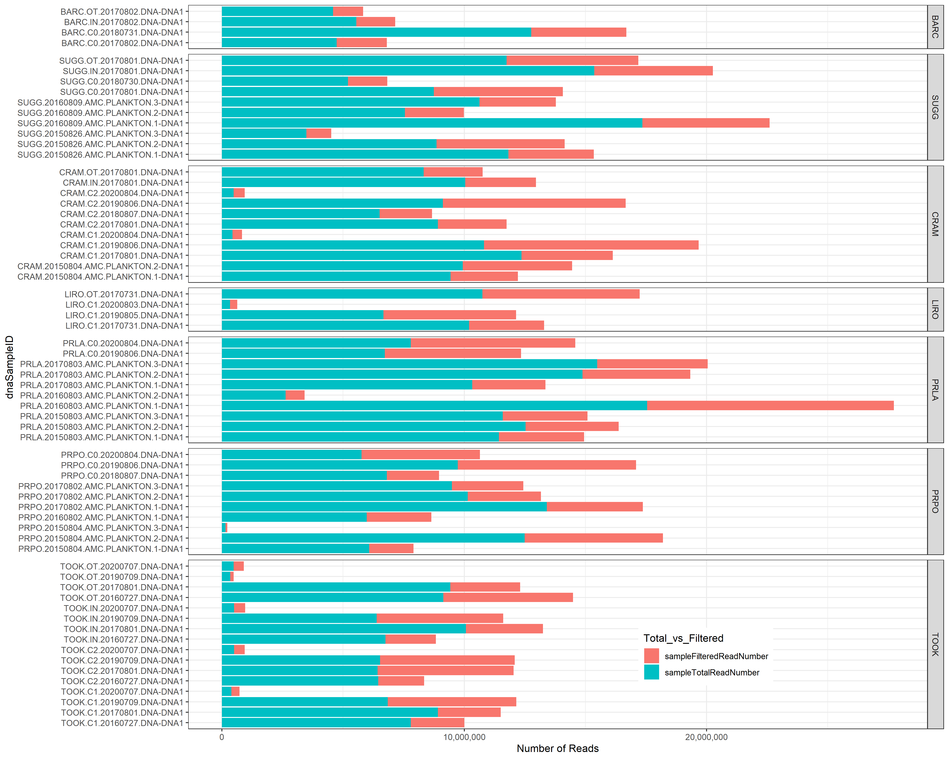
Metagenome data sampled in 2020 in general have pretty low reads

Slide 6
